Slide 1


Human Resource Management Summary Report
By
Hamimi Ben-Anzua MaryAnn
18th December, 2024
This Photo by Unknown Author is licensed under CC BY

Slide 2
OVERVIEW
This HR summary report analyzes the organization's workforce based on metrics extracted from the dashboard. The analysis provides insights into workforce demographics, departmental structure, salary distribution across departments, and hiring trends to support data-driven decision-making.

Slide 3
OBJECTIVES OF REPORT
The purpose of this analysis is to evaluate the organization's workforce and identify areas for improvement in resource allocation, diversity, compensation, and hiring strategies. The insights derived will enable HR teams to make informed decisions, foster employee satisfaction, and align human capital management with business goals.

Slide 4
CONTENTS
Key Performance Indicators
1
Total Salary Expense
3
Total Employees
5
Total Location
2
Average Salary
4
Total Departments
6
Average Age
Charts
1
Location Map of Employees
3
Employee by Department
5
Age Distribution
2
Avg Salary by Department
4
Gender Distribution
6
Employee Start Date Trend

Slide 5
KPIs (Key Performance Indicators)
From the Analysis I derived these key performance indicators
Total Salary Expense:
N3,995,000
Average Salary:
N49,321
Total Employees:
81
6
Total Departments:
Average Age:
32.04
Total Location:
24

Slide 6
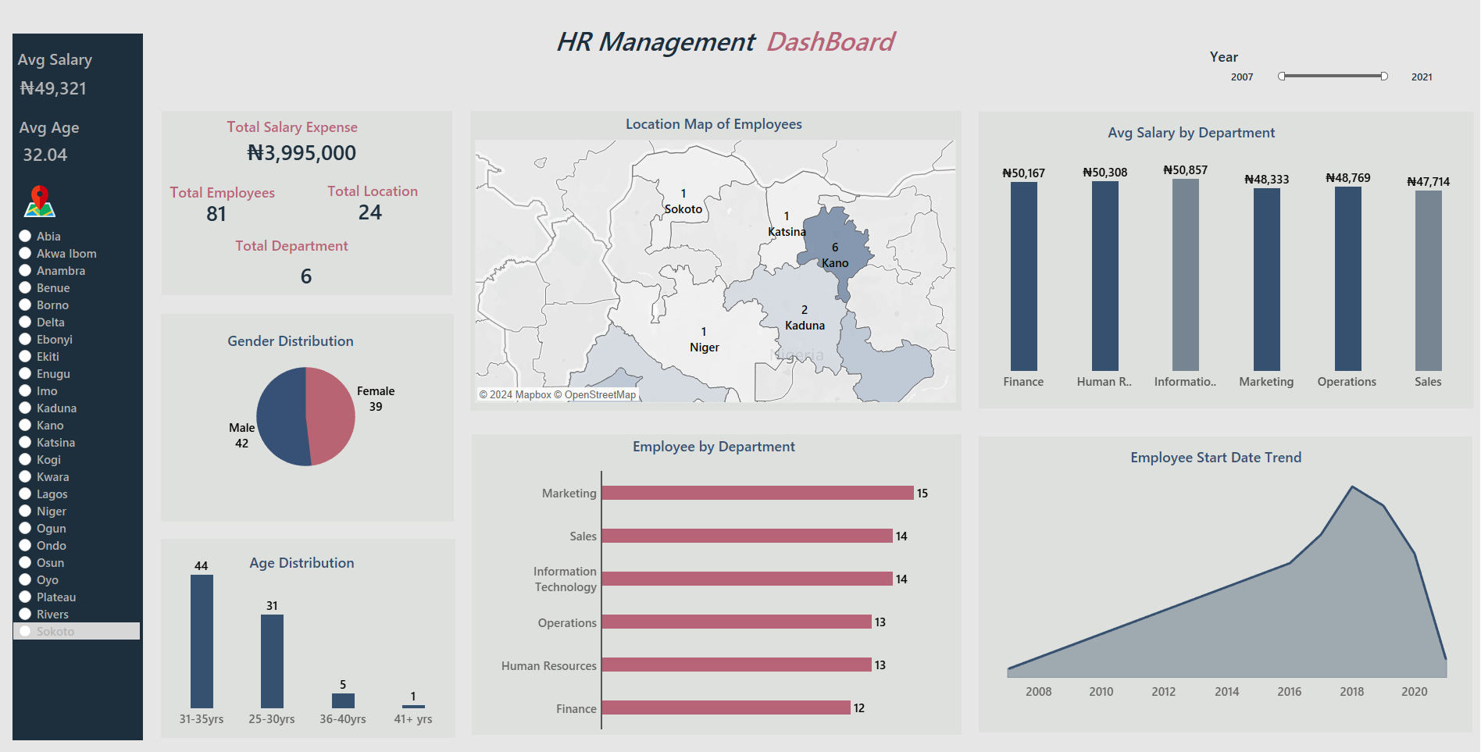

Slide 7
DASHBOARD BREIF
The HR Management Dashboard provides a thorough view of the organization’s workforce, focusing on key metrics such as employee demographics (Age & Gender), salary distribution, departmental breakdown, geographical spread and the hiring trend from 2008-2020. This dashboard is a tool to analyze workforce arrangement, identify trends, and guide strategic HR decisions.

Slide 8
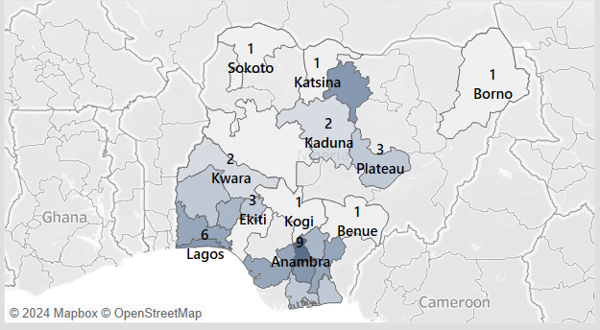
Location Map of Employees
Unequal distribution of employees across locations and departments may indicate challenges in workforce allocation. Locations like Lagos (6 employees), and Anambra (9 employees) are more staffed compared to states like Katsina, Sokoto, and Borno (each with only 1 employee). This suggests an uneven distribution of the workforce geographically.
Certain locations and departments may face performance inconsistency and imbalance of resource utilization.

Slide 9
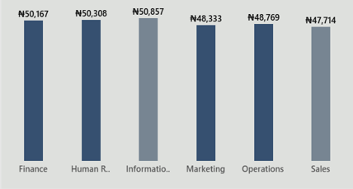
Avg Salary by Department
The average salary is N49,321, with Information Technology , Human Resources and Finance departments having the highest average salaries, while Marketing has the lowest. This may indicate higher skill demand or seniority in specific departments.

Slide 10
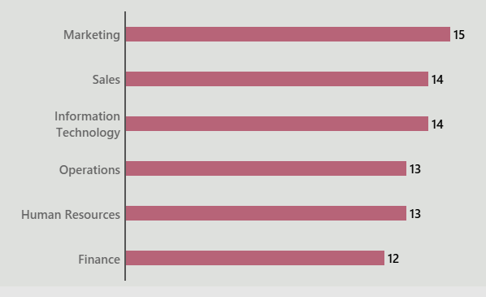
Employee by Department
The department with more employees are Marketing, Sales, and IT (15, 14, and 14 employees, respectively), while Finance has the fewest employees (12).

Slide 11
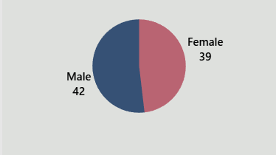
Gender Distribution
The employees are mostly male with 42 employees and 39 female employees.

Slide 12
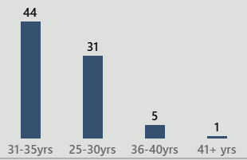
Age Distribution
A significant portion of employees (44) falls within the 31–35-year age group, followed by 31 employees in the 25–30-year range. Only 6 employees are above 36 years, indicating a young workforce with limited seniority and experience.

Slide 13
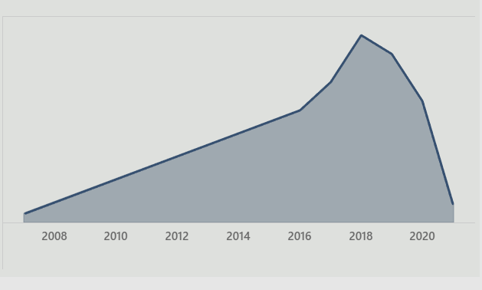
Employee Start Date Trend
Employee start dates show a peak in hiring around 2018, followed by a steep decline, possibly due to external factors or internal factors.

Slide 14
RECOMMENDATIONS
Improve Workforce Allocation
Review staffing needs in underrepresented locations like (Borno, Katsina , etc) and departments with fewer employees, such as Finance.
Promote Talent Acquisition.
Focus on hiring younger talent for departments dominated by the 31–35-year age group to maintain long-term talent sustainability.
Transform Recruitment Strategies
Look into reasons behind the declining employee start trends post-2018 and address challenges in attracting new talent.
Organizational Communication
Create open communication channels between employees and management to understand concerns and implement suggestions.
Prepare for the Unexpected:
Develop backup plans to handle unexpected economic changes, such as:-
Hiring freezes: no new employees can be hired
Budget cuts: less money available for operations

